Slide 1
Rotation Search: Optimization Theory and Algorithms
Liangzu Peng (lpeng25@jhu.edu)
Johns Hopkins University
Presented at the VITA Group, Virtual
Presentation Date: August 17, 2022

Slide 2
Contents
Semidefinite Relaxations of Truncated Least-Squares in Robust Rotation Search: Tight or Not
ECCV 2022
Liangzu Peng, Mahyar Fazlyab, René Vidal
ARCS: Accurate Rotation and Correspondences Search
CVPR 2022
Liangzu Peng, Manolis C. Tsakiris, René Vidal
My publication available at: http://www.liangzu.org/publication.html

Slide 3
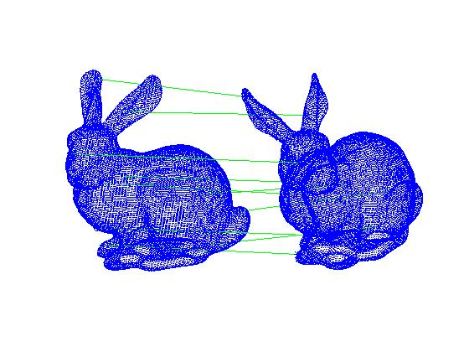
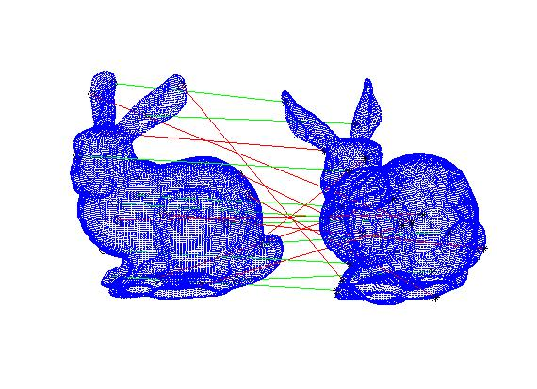
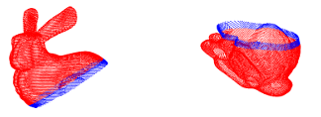
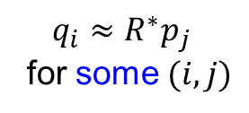
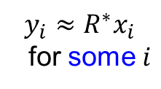
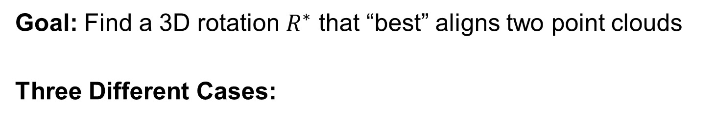
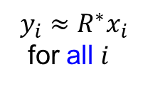
Rotation Search: Problem Setup
Goal: Find a 3D rotation $R^{∗}$ that “best” aligns two point clouds
Three Different Cases:
(2) With Outliers
(3) Correspondence-Less
(Partially Overlapped)
(1) Outlier-Free
$$y_{i}≈R^{∗}x_{i}$$
for all $i$
$$y_{i}≈R^{∗}x_{i}$$
for some $i$
$$q_{i}≈R^{∗}p_{j}$$
for some $(i,j)$

Slide 4
Part I: Theory
Semidefinite Relaxations of Truncated Least-Squares in Robust Rotation Search: Tight or Not
ECCV 2022
Liangzu Peng, Mahyar Fazlyab, René Vidal

Slide 5
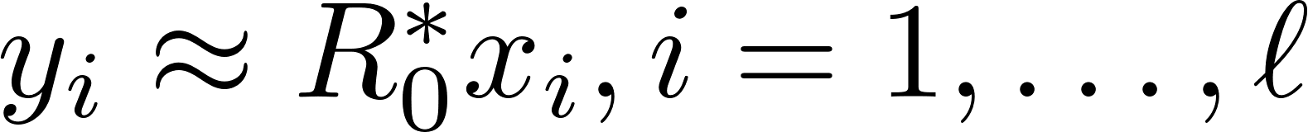

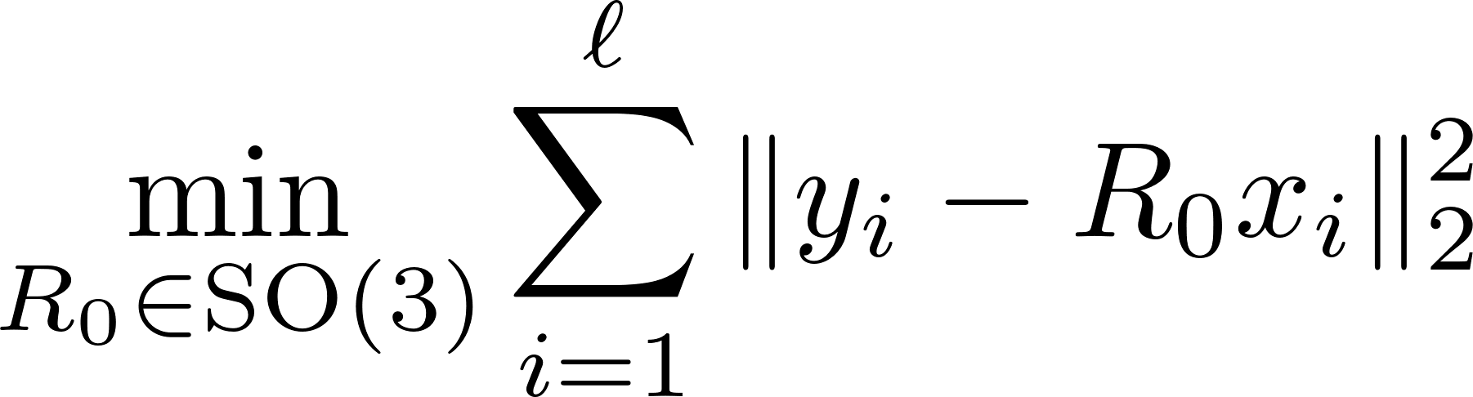
The Outlier-Free Case
Wahba’s Problem
(Wahba, 1965)
G. Wahba. A least squares estimate of satellite attitude.
SIAM Review, 1965

Slide 6
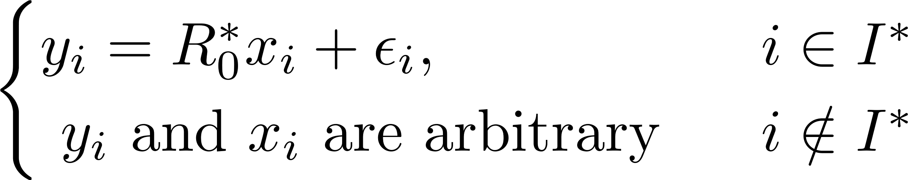
(Outlier-)Robust Rotation Search

Slide 7
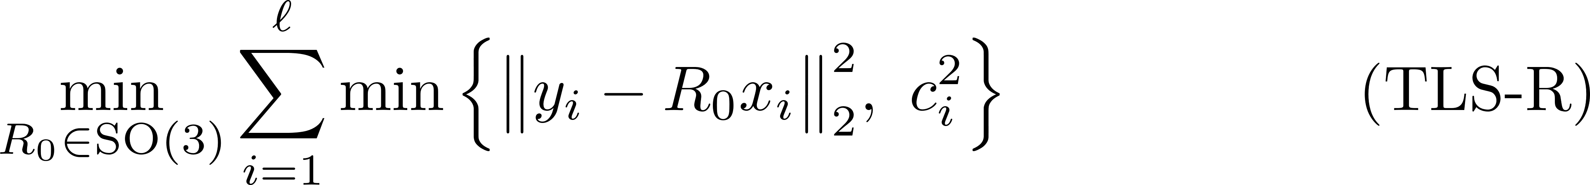
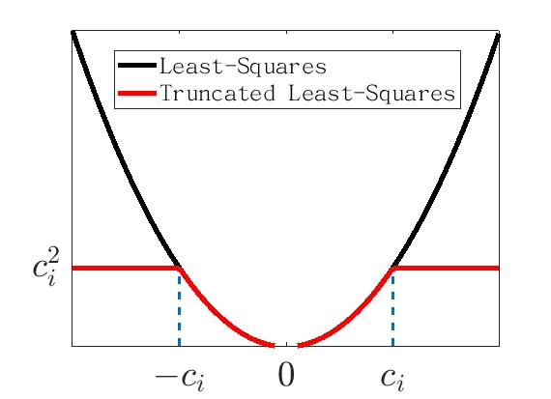
Truncated Least-Squares (Rotation)
H. Yang and L. Carlone. A quaternion-based certifiably optimal solution to the Wahba problem with outliers. ICCV 2019.

Slide 8
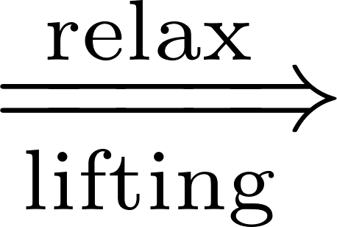

Overview 1/2
1. From (TLS-R) to Its Semidefinite Relaxations
We will derive (based on Yang & Carlone [1]):
(TLS-R) (TLS-Q) (QCQP) (SDR)
Rotation “replaced” by Unit Quaternion
[1] H. Yang and L. Carlone. A quaternion-based certifiably optimal solution to the Wahba problem with outliers. ICCV 2019.

Slide 9

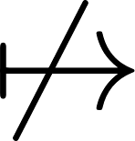
Overview 2/2
2. Tightness of (SDR): mi casa es su casa?
(TLS-R) (TLS-Q) (QCQP) (SDR)
We provide conditions, under which:
global minimizer of (SDR) global minimizer of (QCQP)
or equivalently (SDR) is tight or not
L. Peng, M. Fazlyab, R. Vidal, Semidefinite relaxations of truncated least-squares in robust rotation search: Tight or not, ECCV 2022

Slide 10
Overview 3/3
3. Discussion
(TLS-R) (TLS-Q) (QCQP) (SDR)
Summary with several possible extensions
An open problem that arises in our analysis
(if time permits) (open = I can not solve it)
L. Peng, M. Fazlyab, R. Vidal, Semidefinite relaxations of truncated least-squares in robust rotation search: Tight or not, ECCV 2022

Slide 11

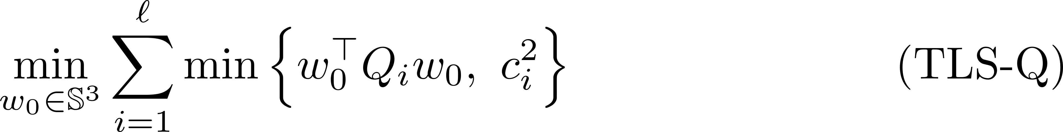
From (TLS-R) to (TLS-Q)
(TLS-R) (TLS-Q) (QCQP) (SDR)
Change of
Optimization
Variables
Change of Data and Residual

Slide 12
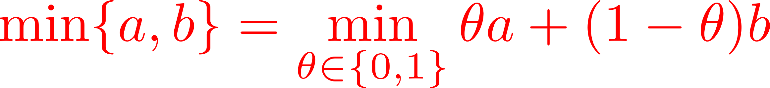
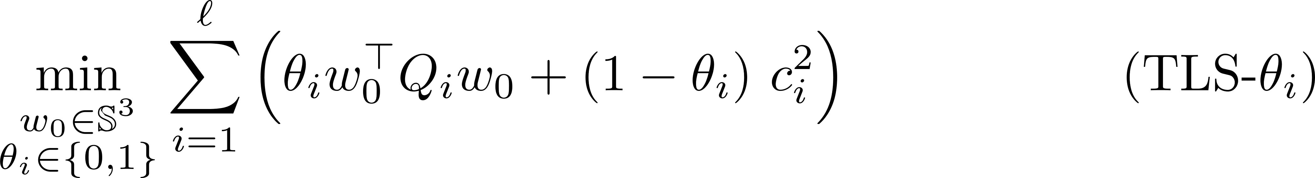
From (TLS-Q) to (QCQP) 1/4
(TLS-R) (TLS-Q) (QCQP) (SDR)
cubic polynomial in entries of the unknowns

Slide 13
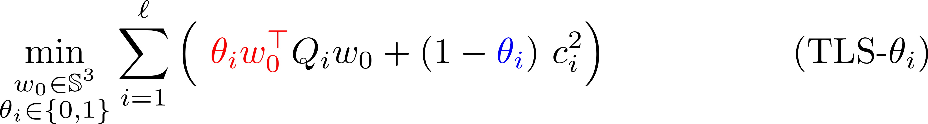
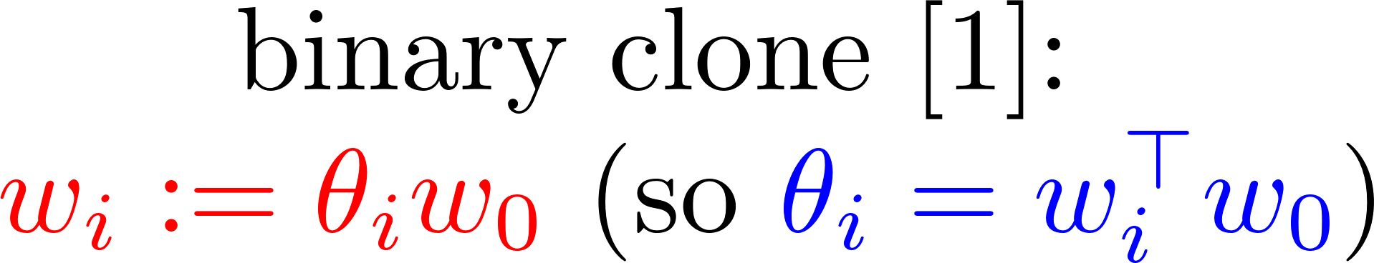
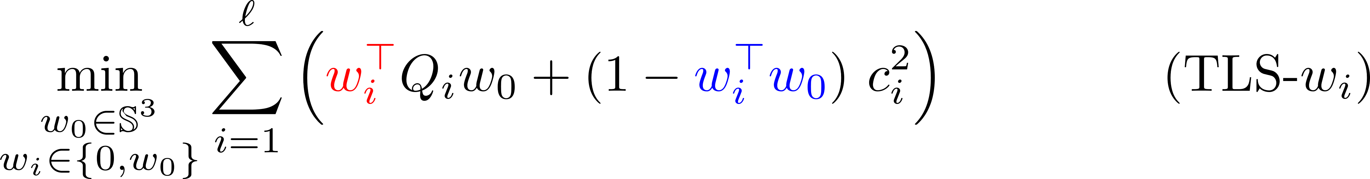
From (TLS-Q) to (QCQP) 2/4
(TLS-R) (TLS-Q) (QCQP) (SDR)
Quadratic Obj.
[1] H. Yang and L. Carlone. A quaternion-based certifiably optimal solution to the Wahba problem with outliers. ICCV 2019.

Slide 14
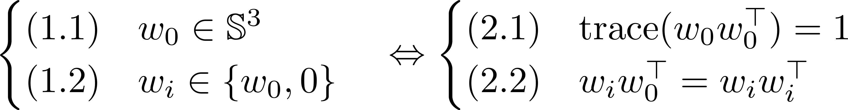
From (TLS-Q) to (QCQP) 3/4
(TLS-R) (TLS-Q) (QCQP) (SDR)
Quadratic Obj.
Constraints are also quadratic:

Slide 15
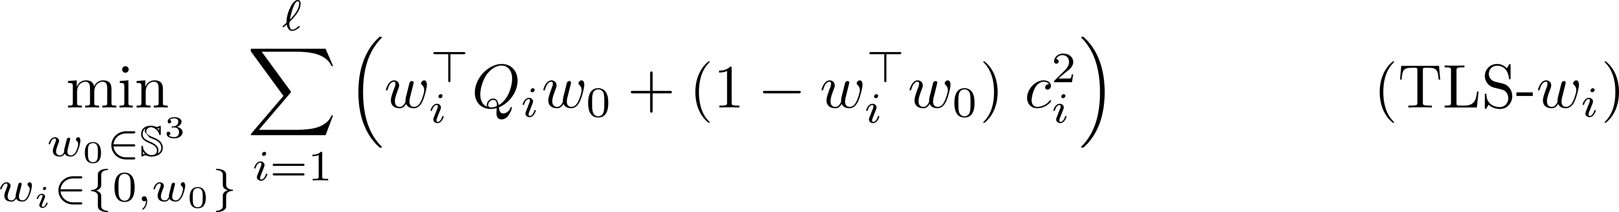
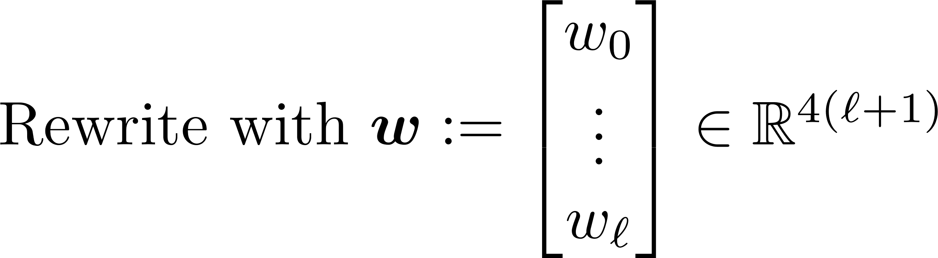
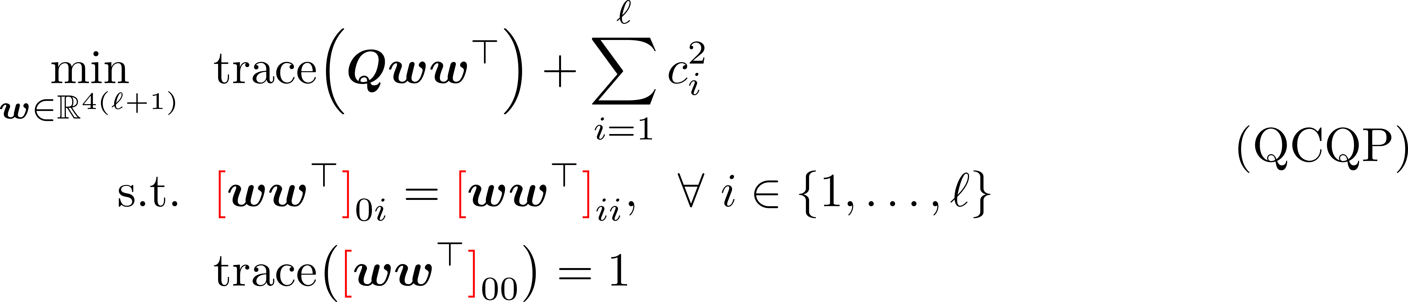
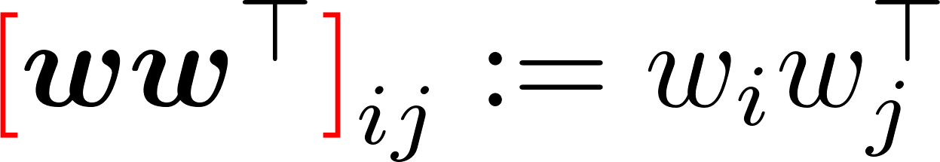
From (TLS-Q) to (QCQP) 4/4
(TLS-R) (TLS-Q) (QCQP) (SDR)
Change of Data

Slide 16

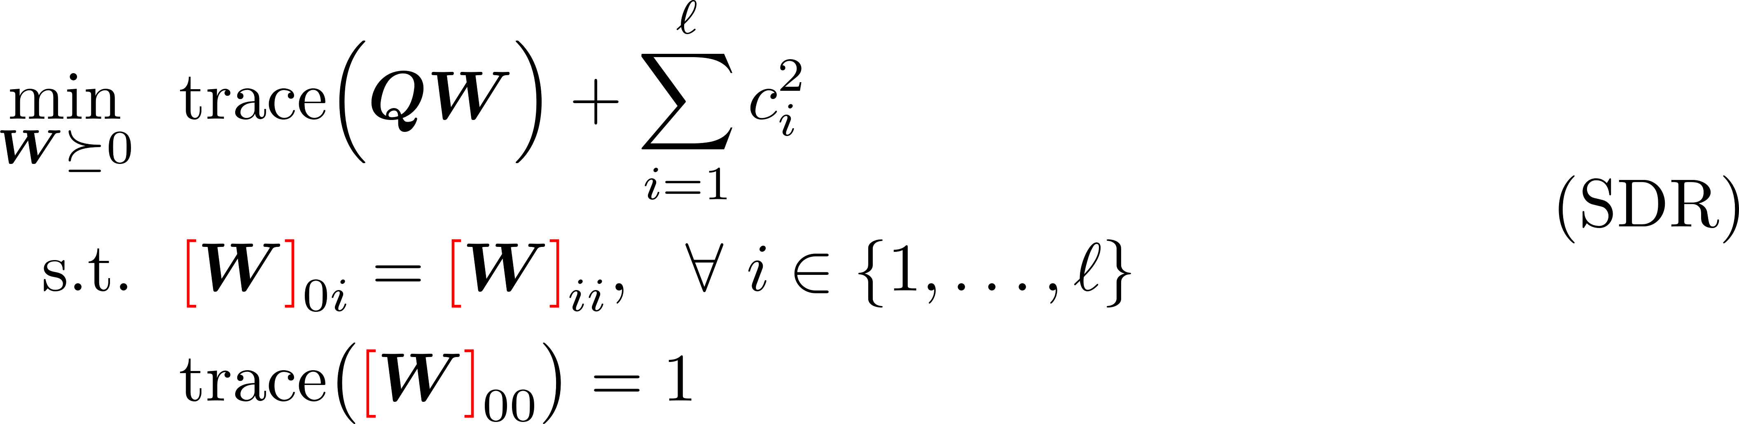
From (QCQP) to (SDR)
(TLS-R) (TLS-Q) (QCQP) (SDR)
Lifting

Slide 17

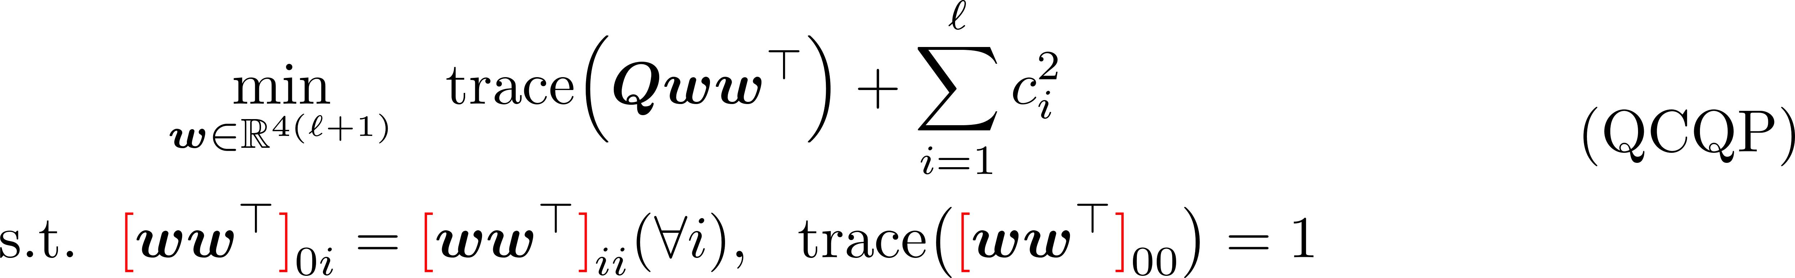
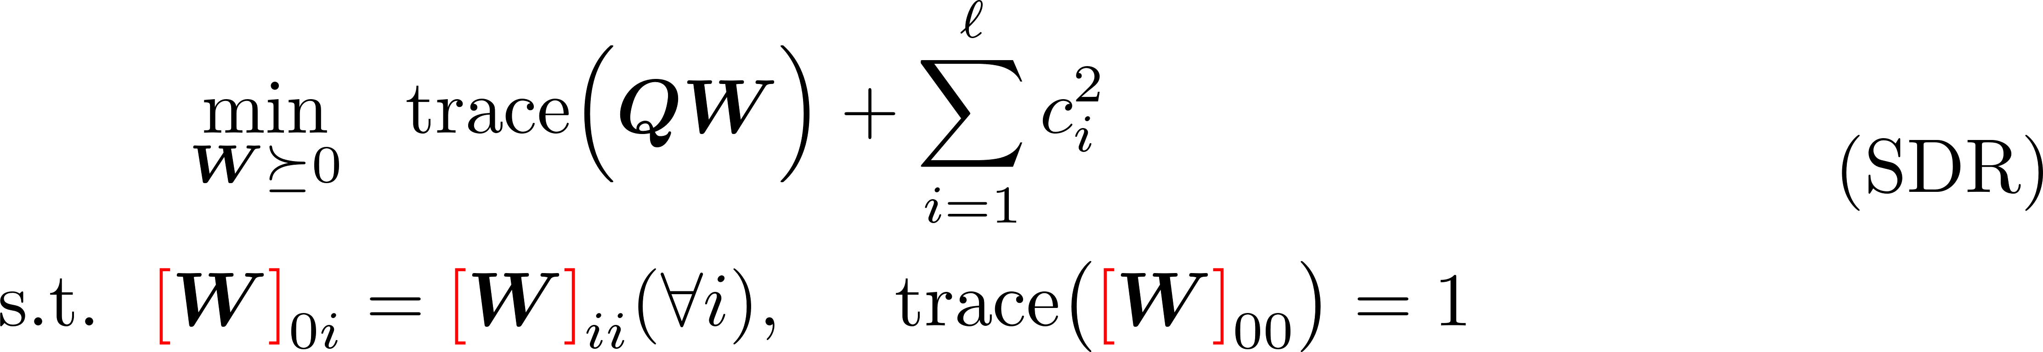
Interim Summary
Rotation Unit Quaternion
Binary Cloning
Lifting

Slide 18
Tightness of (SDR) 1/7
Definition (Tightness, mi casa es su casa):
(TLS-R) (TLS-Q) (QCQP) (SDR)

Slide 19
Tightness of (SDR) 2/7
Structure of Our Theorems:
(TLS-R) (TLS-Q) (QCQP) (SDR)
Theorem 2
w/o noise
w/ outliers
Theorem 1
w/o noise
w/o outliers
Theorem 4
w/ noise
w/ outliers
Theorem 3
w/ noise
w/o outliers
[1] H. Yang and L. Carlone. A quaternion-based certifiably optimal solution to the Wahba problem with outliers. ICCV 2019.

Slide 20



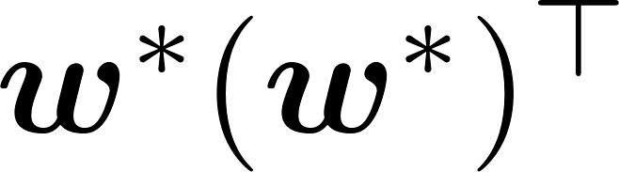
Tightness of (SDR) 3/7
Theorem 1:
(TLS-R) (TLS-Q) (QCQP) (SDR)
Ground-Truth:
Compared to [1], our proof is simpler and shorter.
[1] H. Yang and L. Carlone. A quaternion-based certifiably optimal solution to the Wahba problem with outliers. ICCV 2019.

Slide 21
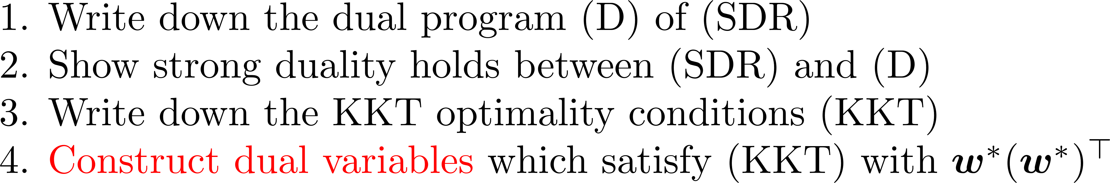
Tightness of (SDR) 4/7
Theorem 1:
(TLS-R) (TLS-Q) (QCQP) (SDR)
Ground-Truth:
High-Level Proof:
L. Peng, M. Fazlyab, R. Vidal, Semidefinite relaxations of truncated least-squares in robust rotation search: Tight or not, ECCV 2022

Slide 22
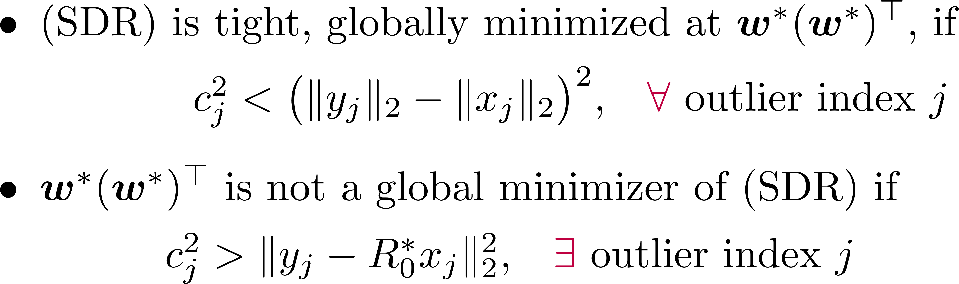
Tightness of (SDR) 5/7
Theorem 2:
(TLS-R) (TLS-Q) (QCQP) (SDR)
Ground-Truth:
Limitations: Theorem 2 does not tell
What happens if
how far the global minimizer of (SDR) is from

Slide 23
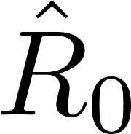


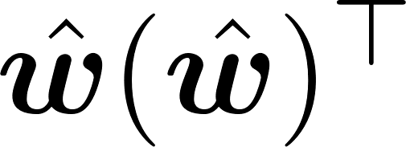
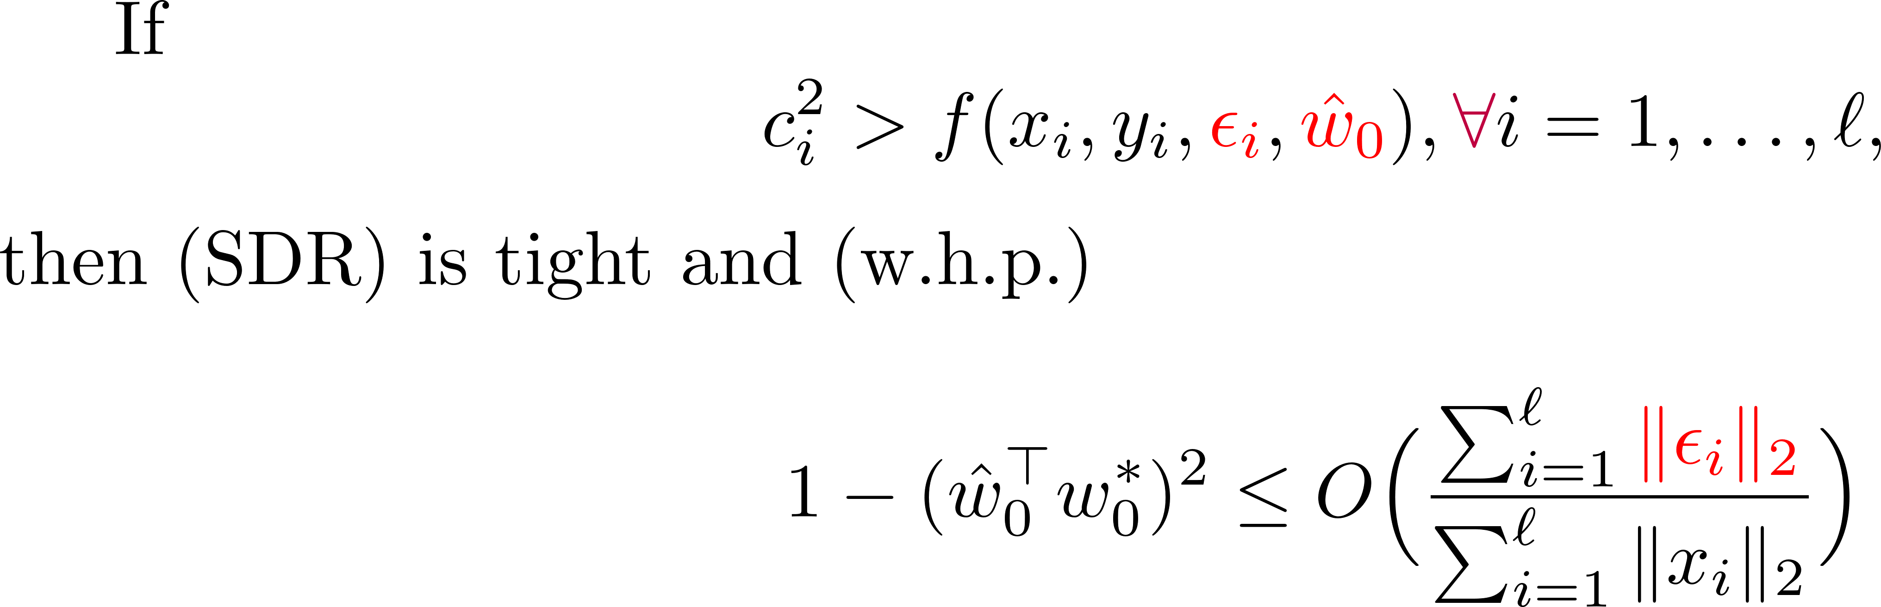
Tightness of (SDR) 6/7
Theorem 3:
(TLS-R) (TLS-Q) (QCQP) (SDR)
Ground-Truth:
Global Minimizer:

Slide 24
Tightness of (SDR) 7/7
Theorem 4:
(TLS-R) (TLS-Q) (QCQP) (SDR)
Ground-Truth:
Global Minimizer:
Suppose
the conditions of Theorem 2 hold for outlier point pairs
(noiseless + with outliers)
the conditions of Theorem 3 hold for inlier point pairs
(noisy without outliers)
Then (SDR) is tight.

Slide 25
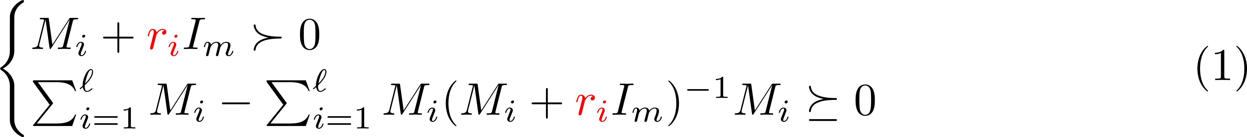

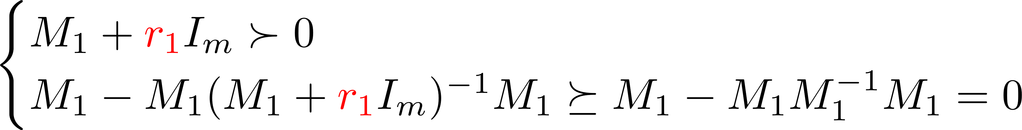
An Open Problem
Remark 1:
Remark 2:

Slide 26
Future Works (Part I)
Analyze a tighter relaxation of robust rotation search [1]
E.g. at the second relaxation order of the Lasserre hierarchy
Empirically very tight, little to none theoretical justification
Extend the analysis to related geometric vision problems
Particularly for the truncated least-squares objective
See [2] for several examples
Classic geometric vision is far from being well-understood!
Modern tools from optimization, statistics are needed to do so
[1] H. Yang and L. Carlone. A quaternion-based certifiably optimal solution to the Wahba problem with outliers. ICCV 2019.
[2] H. Yang and L. Carlone. Certifiably optimal outlier-robust geometric perception: Semidefinite relaxations and scalable global optimization. T-PAMI 2022.

Slide 27
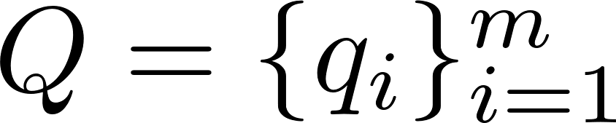
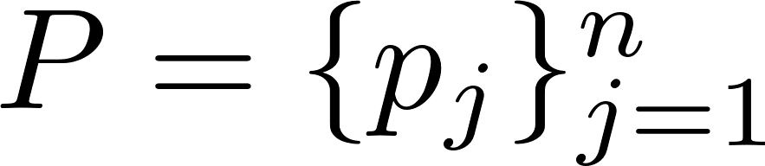
Part II: Algorithm
ARCS: Accurate Rotation and Correspondences Search
CVPR 2022
Liangzu Peng, Manolis C. Tsakiris, René Vidal
Correspondence-Less (Partially Overlapped)
additive noise
Goal:

Slide 28
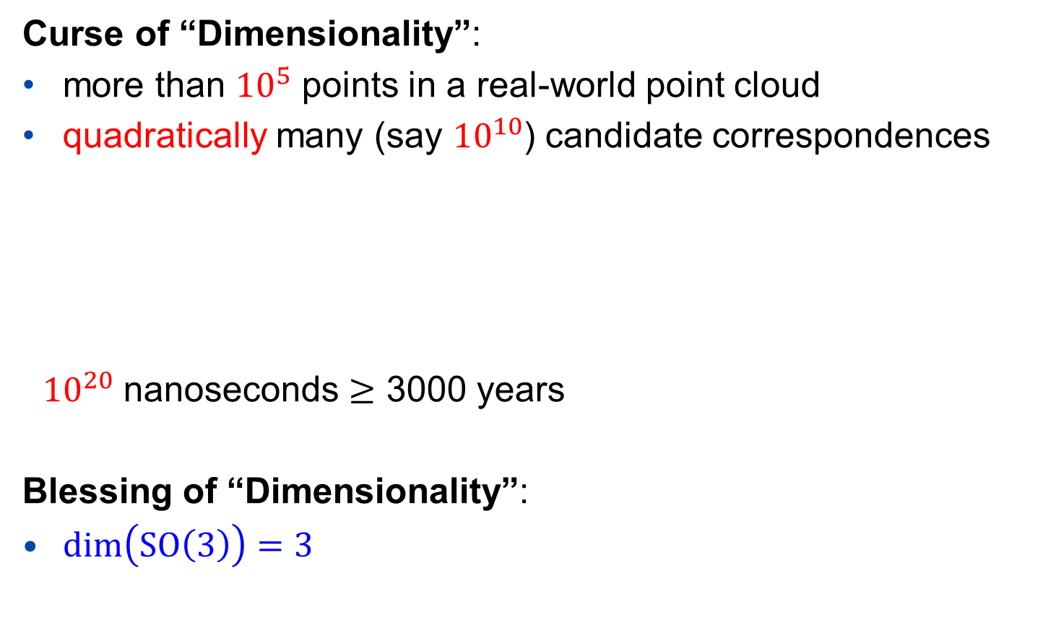
The Curse and Blessing
Curse of “Dimensionality”:
more than ${10}^{5}$ points in a real-world point cloud
quadratically many (say ${10}^{10}$) candidate correspondences
${10}^{20}$ nanoseconds $≥$ 3000 years
Blessing of “Dimensionality”:
$\dim\left(SO\left(3\right)\right)=3$
“Quadratic algorithms are useless
in modern applications.”
------ Robert Sedgewick

Slide 29
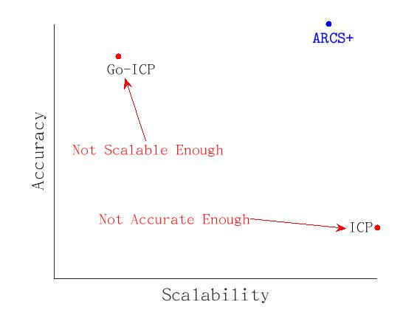
Scalability versus Accuracy Dilemma
Scalable, not accurate
The ICP algorithm, and its variants
Accurate, not scalable
The Go-ICP algorithm, and its variants
Our Solution ARCS+
Go-ICP: J. Yang, H. Li, D. Campbell, Y. Jia, “Go-ICP: A Globally Optimal Solution to 3D ICP Point-Set Registration”, TPAMI 2016.
ICP: P.J. Besl, N.D. McKay, “A Method for Registration of 3-D Shapes”. TPAMI 1992.

Slide 30
The Design of The ARCS+ Algorithm
Desiderata:
ARCS+ should maximize the “Blessing of Dimensionality”
ARCS+ should run in linear-logarithmic time in the input size
ARCS+ consists of three steps:
Step 1: Establish Correspondences
Step 2: Outlier Removal
Step 3: Rotation Refinement

Slide 31
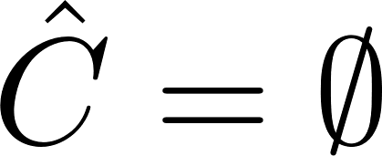
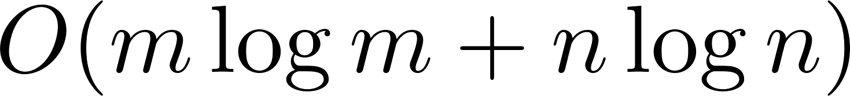
The ARCS+ Algorithm: Step 1
Step 1: Establish Correspondences
Initialization:
For every i=1,…,m, and j=1,…,n (double for loop)
Key Idea: Step 1 can be implemented in linear-logarithmic time
Step 1 reduces the correspondence-less problem to
Robust Rotation Search

Slide 32
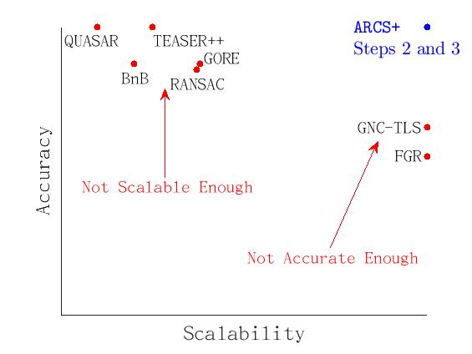

Scalability versus Accuracy Dilemma (cont.)
Our Solution (ARCS+, Steps 2 and 3)
Robust Rotation Search Algorithms

Slide 33
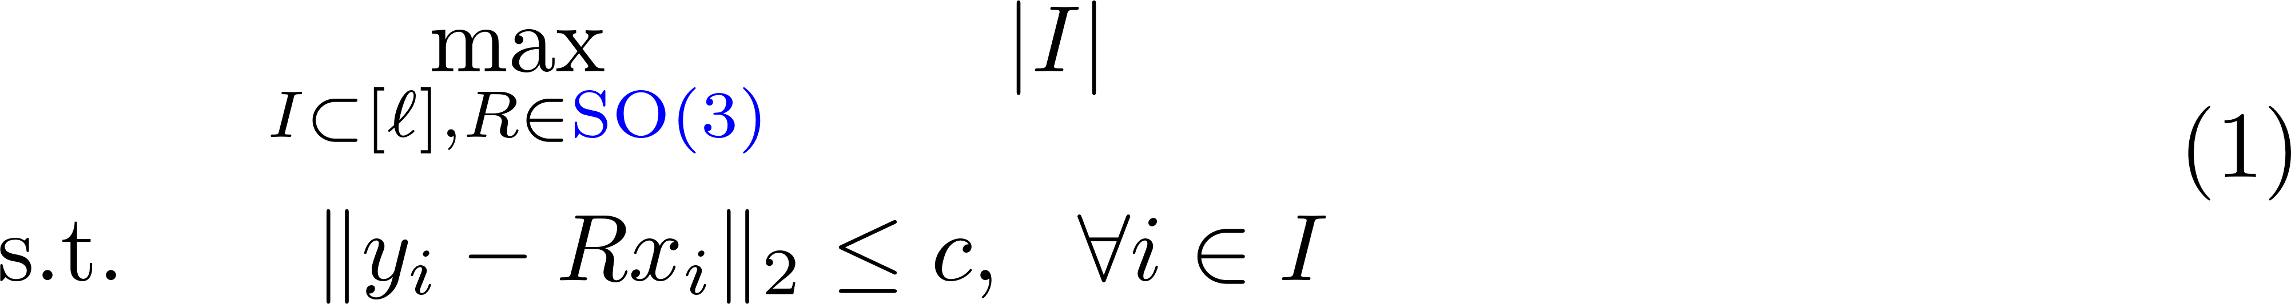
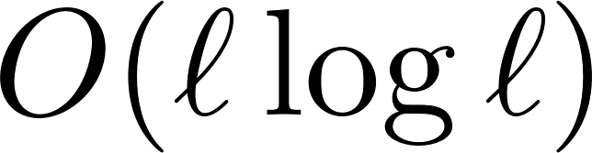
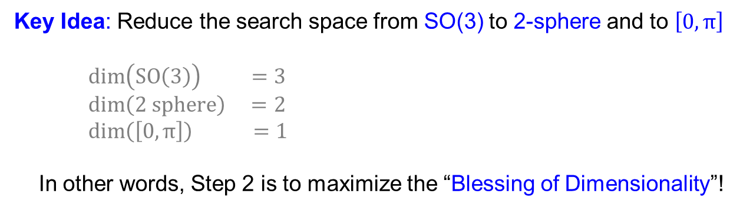
Step 2 of ARCS+: Outlier Removal 1/2
Consensus Maximization
Claim:
(1) can be solved approximately in linear-logarithmic time
Key Idea: Reduce the search space from SO(3) to 2-sphere and to $\left[0,π\right]$
$\dim\left(SO\left(3\right)\right) =3$
$\dim\left(2 sphere\right) =2$
$\dim\left(\left[0,π\right]\right) =1$
In other words, Step 2 is to maximize the “Blessing of Dimensionality”!

Slide 34
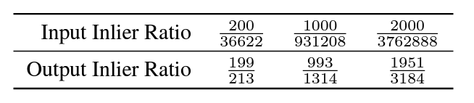
Step 2 of ARCS+: Outlier Removal 2/2
Performance of Step 2
More than 3 million outlier point pairs are removed!
The final step:
Refine the rotation on the remaining point pairs
In the paper, we consider random, non-adversarial outliers

Slide 35
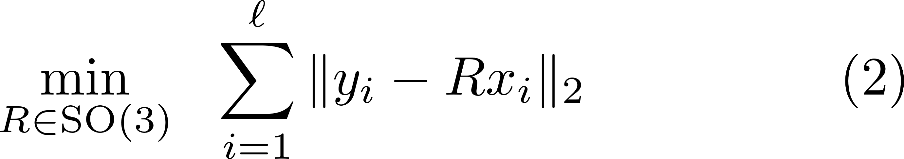
Step 3 of ARCS+: Rotation Refinement 1/3
L1 Minimization (“sum of unsquared deviations”)
Non-Convex (due to the constraint)
Non-Smooth (due to the objective)
The First Thought:
Riemannian Subgradient Descent
Problem: hard to derive theoretical guarantees
E.g., SO(3) has a determinant constraint

Slide 36
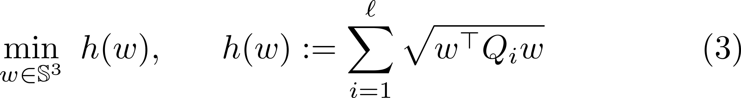
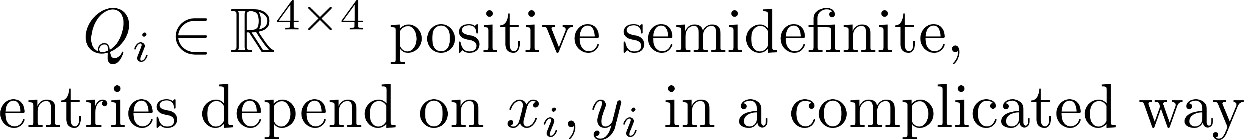
Step 3 of ARCS+: Rotation Refinement 2/3
L1 Minimization (“sum of unsquared deviations”)
Non-Convex (due to the constraint)
Non-Smooth (due to the objective)
The Second Thought:
Riemannian Subgradient Descent on Unit Quaternions
Claim: (2) is equivalent to

Slide 37

Step 3 of ARCS+: Rotation Refinement 3/3
L1 Minimization (“sum of unsquared deviations”)
Non-Convex (due to the constraint)
Non-Smooth (due to the objective)
The Final Algorithm:
Claim (informal): Under mild conditions, the algorithm converges locally at a linear rate, e.g.,

Slide 38
ARCS+: Scalability & Accuracy in Numbers
ARCS+ is correspondence-free and can handle:
more than a million points with 2 overlapping points without noise
roughly ten thousand points with 20% overlaps under small noise
ARCS+ (Steps 2 and 3) can handle:
ten million point pairs with 0.03% inliers
See our paper for more formal experimental report.

Slide 39
Future Works (Part II)
Extend ARCS+ to the rotation + translation case
A trivial extension is in the appendix of our paper
Need a smarter and more scalable extension
Feature learning from point clouds
Desiderata 1: It should be interpretable by design [1]
Desiderata 2: It should be more scalable
Current deep learning methods can only “handle” thousands of points
[1] A. Chattopadhyay, S. Slocum, B. D. Haeffele, R. Vidal, D. Geman
“Interpretable by Design: Learning Predictors by Composing Interpretable Queries”
arXiv:2207.00938 [cs.CV]

Slide 40
More Information
This work was supported by grants NSF 1704458, NSF 1934979 and ONR MURI 503405-78051.
Vision Lab @ JHU http://www.vision.jhu.edu
Center for Imaging Science @ JHU http://www.cis.jhu.edu
Mathematical Institute for Data Science @ JHU http://www.minds.jhu.edu
Thank You!

